Slide 1
ShanghaiTech University
EE 115B: Digital Circuits
Fall 2024
Lecture 11
Hengzhao Yang
November 12, 2024

Slide 2
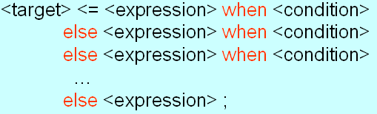
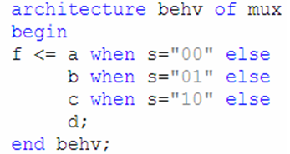
Concurrent: conditional signal assignment
A signal can be assigned one of several values based on a condition.
Syntax
Example

Slide 3
Concurrent: conditional signal assignment
Keywords: when-else
  <target> can be an internal signal or an output port
  <expression> operates on internal signals or input ports when <condition> is true
  Last else branch covers all missing conditions

Slide 4
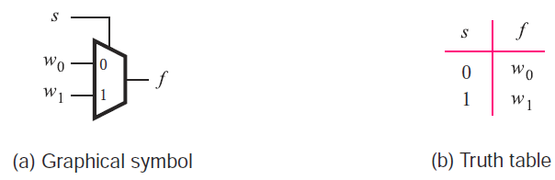
Example: 2-to-1 mux (ch. 6)
Truth table

Slide 5
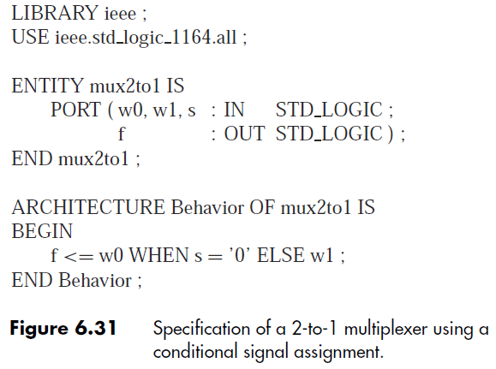
Example: 2-to-1 mux

Slide 6
VHDL design description
Behavioral
  Model a circuit based on its functionality
Structural
  Build a complex circuit based on components (lower-level circuits)

Slide 7
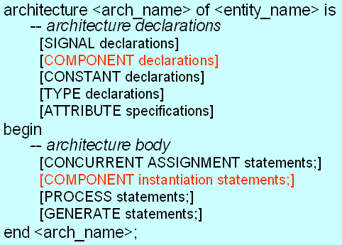
Component
An entity defined in one source code file can be used as a component in another source code file.
Requires component declaration and component instantiation statements.

Slide 8
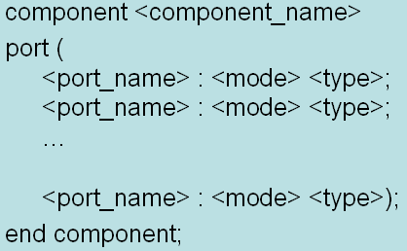
Component: declaration
Syntax
Example
  <component_name> must be the name of the entity to be used.

Slide 9
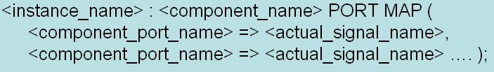
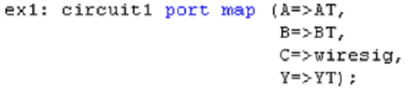
Component: instantiation
Syntax 1: positional association
Syntax 2: named association
Example

Slide 10
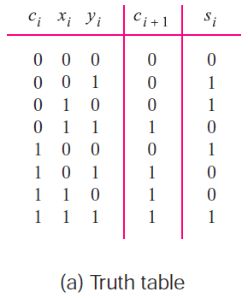
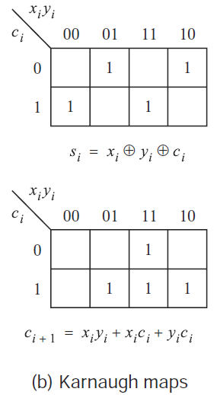
Example 1: 4-bit full adder
Truth table for 1-bit full adder

Slide 11
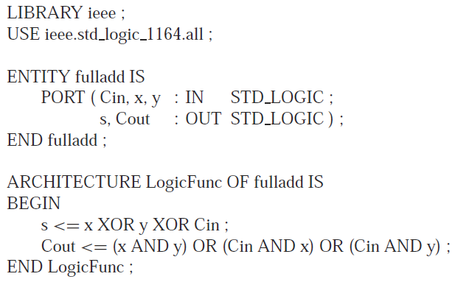
Example 1: 4-bit full adder
VHDL code for 1-bit full adder

Slide 12
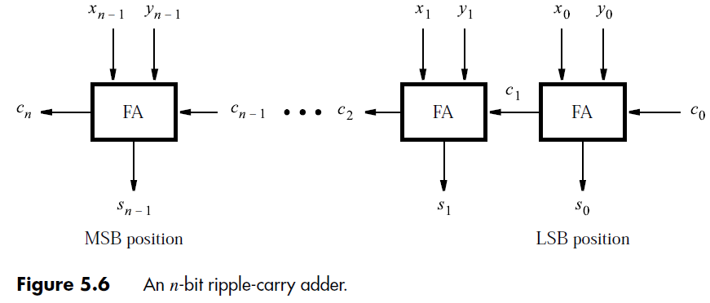
Example 1: 4-bit full adder
General form: n-bit full adder

Slide 13

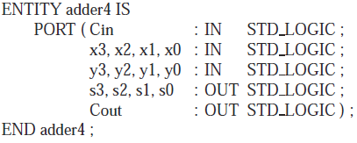
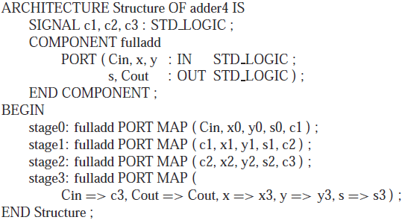
Example 1: 4-bit full adder

Slide 14
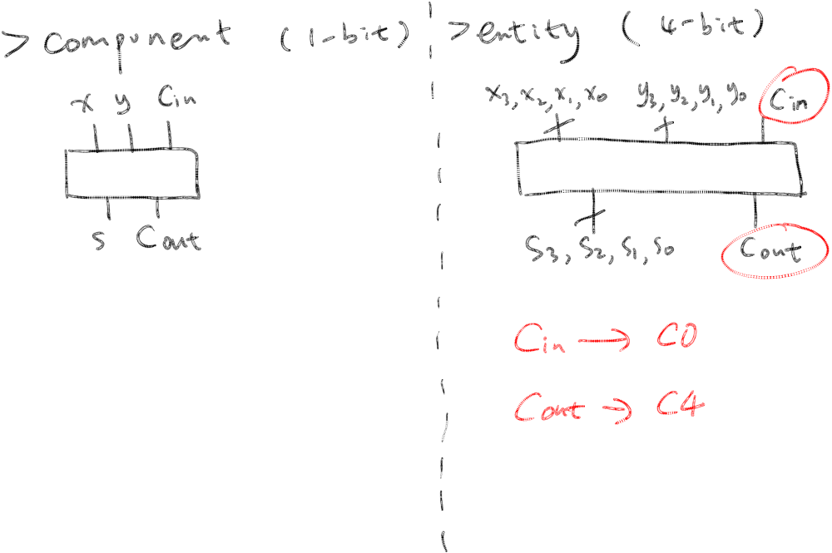
Component vs. Entity

Slide 15
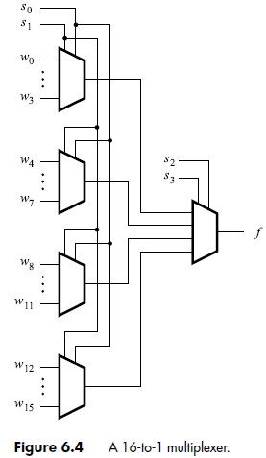
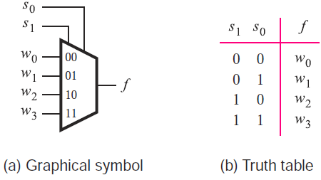
Example 2: 16-to-1 mux
Truth table for 4-to-1 mux

Slide 16
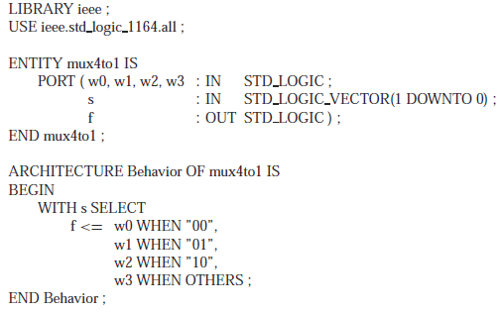
Example 2: 16-to-1 mux
VHDL code for 4-to-1 mux

Slide 17

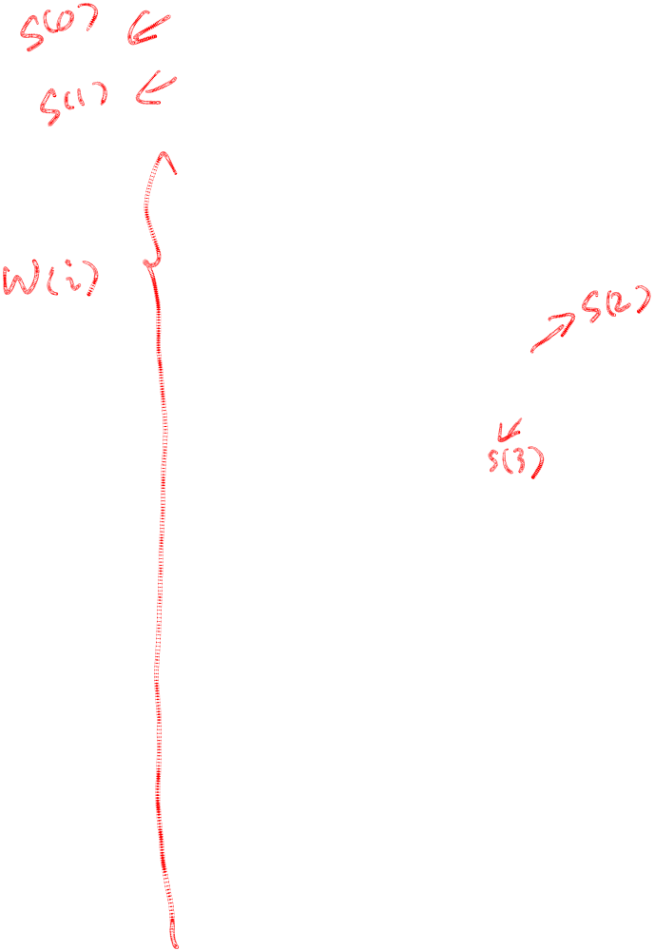
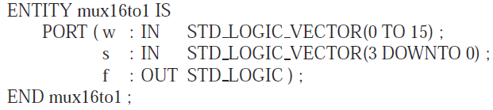

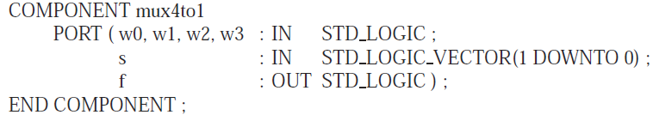
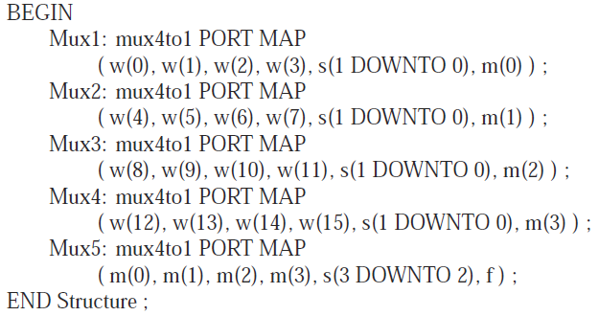
Example 2: 16-to-1 mux

Slide 18
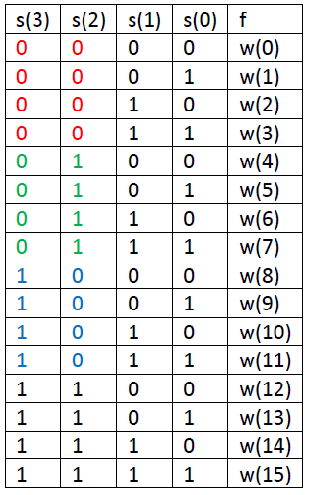
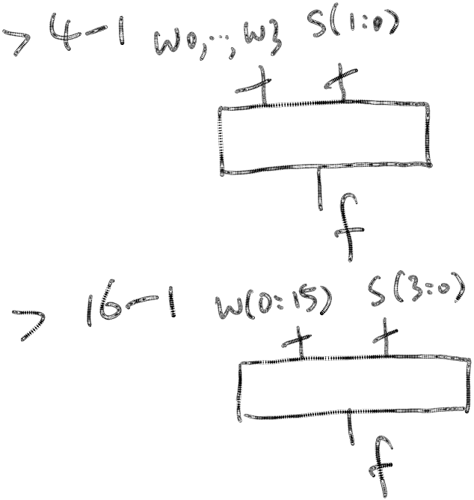
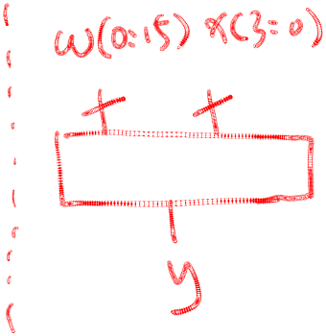
16-to-1 mux: operation
Select signal
  s(3)s(2): select block
  s(1)s(0): select input

